Slide 1
Exploiting Transferability: A New Perspective of Studying the Adversarial Attacks and Defences
candidature assessment 1
Gurparteek Singh
12027013
27/10/2021
Notes:
Hello everyone!
Thank you for joining today.
I will be discussing my candidate assessment 1 on the topic of exploiting transferability….

Slide 2
Table of Content
1. Introduction – Deep Learning and Adversarial Attacks
2. Motivation – Transferability Property
3. Background
4. Transferable Attacks and Defences
5. Future Research Opportunities
6. Candidature Assessment 1 Progress

Slide 3
Introduction
Deep Learning and Adversary

Slide 4

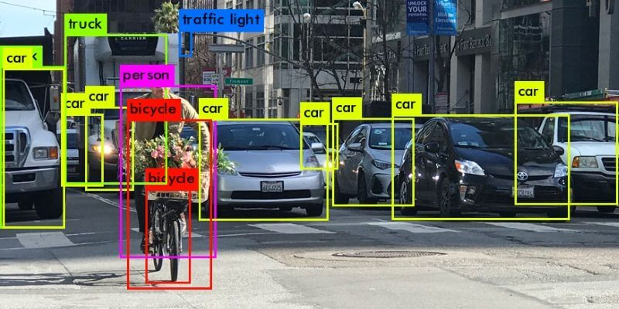

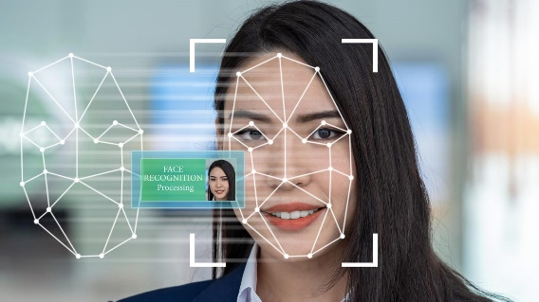

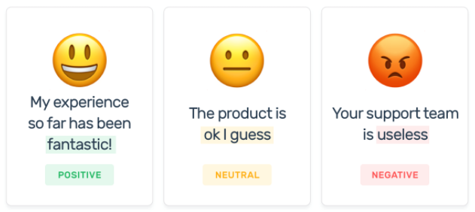
Deep Learning
A Deep Neural Network (DNN) is a complex set of algorithms which are designed to detect patterns and mimic how the human brain makes decisions, without any explicit programming.
Natural Language Processing
Computer Vision
Other Domains
Fake News Detection
Self-Driving Car
Malware Detection
Sentimental Analysis
Facial Recognition
Speech Recognition
Notes:
Deep learning has been a very popular research topic in recent years due to the wide variety of artificial
intelligence applications with the potential to benefit from.

Slide 5
Deep Neural Network (DNN): Computer Vision
Input
Hidden Layers
Output
Image Source: https://becominghuman.ai/building-an-image-classifier-using-deep-learning-in-python-totally-from-a-beginners-perspective-be8dbaf22dd8
Notes:
Simple image classification example
Complex example: self-driving car making real time decisions to identify objects, cars, pedestrians, stop sign.

Slide 6
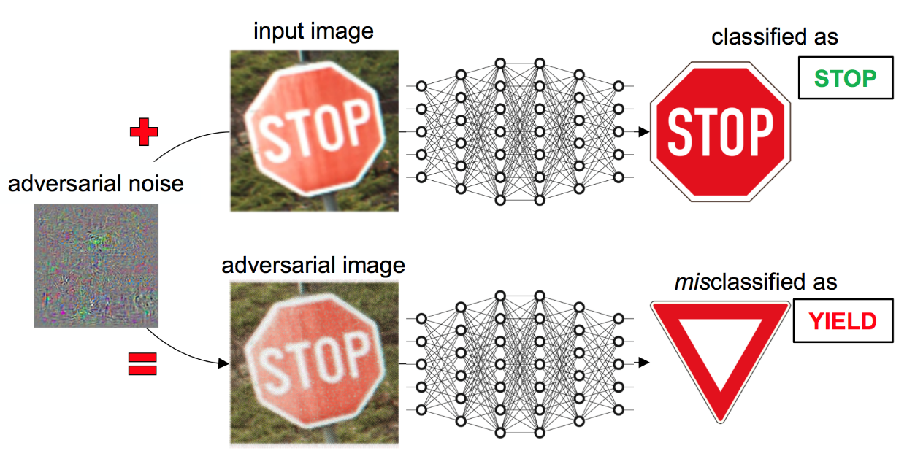
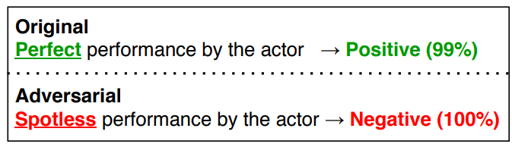
Adversarial Examples
Despite many benefits, DNNs are vulnerable to adversarial attacks where the output can be manipulated by adding a strategically generated noise to the input.
[2] TextAttack
Morris, J.X., Lifland, E., Yoo, J.Y., Grigsby, J., Jin, D. and Qi, Y., 2020. Textattack: A framework for adversarial attacks, data augmentation, and adversarial training in nlp. arXiv preprint arXiv:2005.05909.
[1] Stop sign adversarial attack
Eykholt, K., Evtimov, I., Fernandes, E., Li, B., Rahmati, A., Xiao, C., Prakash, A., Kohno, T. and Song, D., 2018. Robust physical-world attacks on deep learning visual classification. In Proceedings of the IEEE conference on computer vision and pattern recognition (pp. 1625-1634).
Image Source: https://sec-ml.pluribus-one.it/wild-patterns/

Slide 7
Motivation
Transferability Property

Slide 8
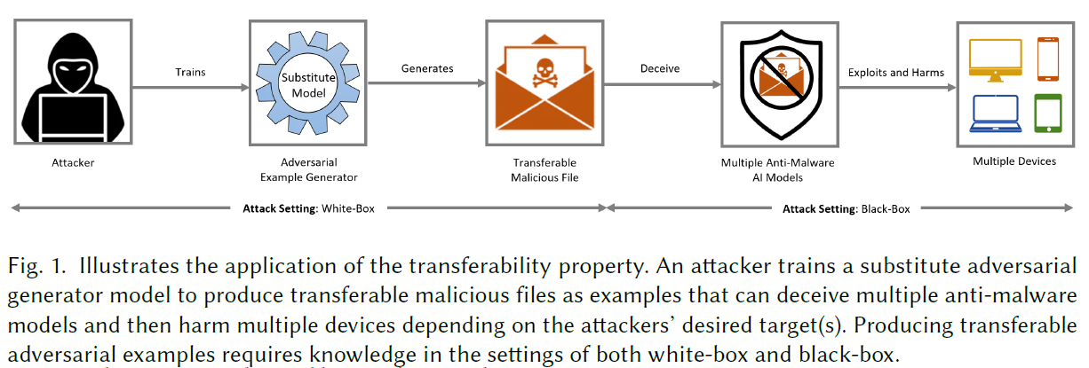
Motivation: Transferability Property
DNNs are easy to manipulate with high confidence
Only little noise needs to be added to achieve high confidence incorrect labels
Transferable: Adversarial examples generated on one model can manipulate multiple target models.
Concern for security critical applications in many domains.
Vital to defend against transferable adversarial attacks.
Notes:
3) The transferability property of adversarial perturbations poses a large risk for security-critical
applications, as an adversary attack generated to manipulate one model can often manipulate
another.

Slide 9
Background

Slide 10
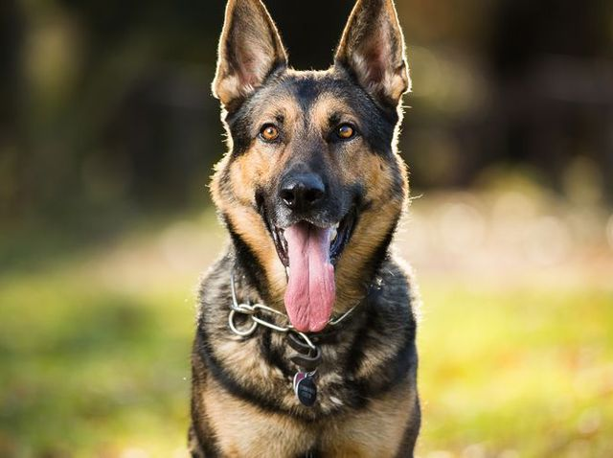
Adversarial Goal
Goal of the adversarial attack is manipulate the output label using an adversarial examples which looks close as possible to the original example to the human eyes.
For a classification neural network F(x) = y
Given input x classified as label L
Easy to find an x* close to x
So that F(x*) = L*
i.e. the network identifies the image on right as a cat.

Slide 11
Threat Model
Un-targeted Attacks
Instead of classifying the input x as a given target class, we only search for an input x* so that C(x*) != C*(x) and x, x* are close.
Targeted Attacks
Find a similar input x* such that C(x*) = target label yet x, x* are close.
Targeted attacks are not considered in our survey paper as they are difficult to transfer.
White-Box Attacks
Attacker has full internal knowledge of DNN including training dataset, training parameters, architecture, etc.
Black-Box Attacks
Attacker has no internal knowledge.

Slide 12
Distance Metrics
Distance metrics are used to quantify similarity.
Below are the three distance metrics and examples in the image classification domain:
L0 Corresponds to the number of pixels altered in an image.
L2 distance measures the standard Euclidean distance (root-mean-square) between x and x*
L∞ measures the maximum change to any of the coordinates. Each pixel is allowed to be changed up to a budgeted limit.

Slide 13



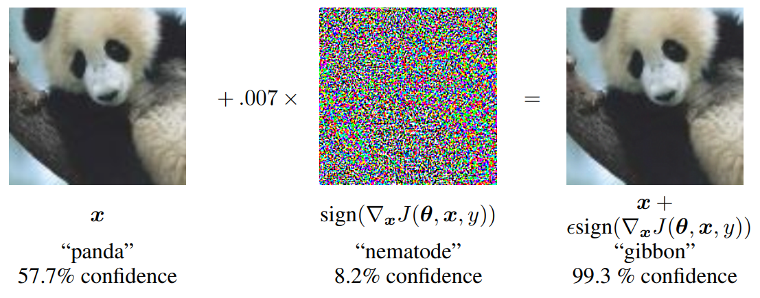
Foundation Attack Algorithms
1. L-BFGS
2. FGSM
3. FGM
4. JSMA
5. Deepfool
6. C&W
Fast Gradient Sign Method [1]
)
Where:
x* = adversarial example
x = original example
= perturbation strength, usually small so adversarial example is undetectable
= gradient of the loss function with respect to x
y = true label of input x
[1] Goodfellow, I.J., Shlens, J. and Szegedy, C., 2014. Explaining and harnessing adversarial examples. arXiv preprint arXiv:1412.6572.
Notes:
Fast Gradient Sign Method
Designed to be very fast instead of producing a very close adversarial example.
*read slide
Gradient of the loss function with respect to x to determine in which direction the pixel’s intensity should be changed (increase of decrease) to minimise loss function.
Shifts all pixels simultaneously
Loss Function: Measure of how accurate the network it. High number is not accurate and low number is accurate.
Each foundation attack algorithm is optimised for a certain distance metric:
L-BFGS and Deepfool for L2
JSMA for L0
FGSM and DGM for L-Infinity
FGSM is a one step algorithm, recently iterative algorithms used…

Slide 14
Transferable Attacks and Defences
Scenarios and Research Questions
Notes:
How did we study transferable attacks and defences from a different perspective?

Slide 15
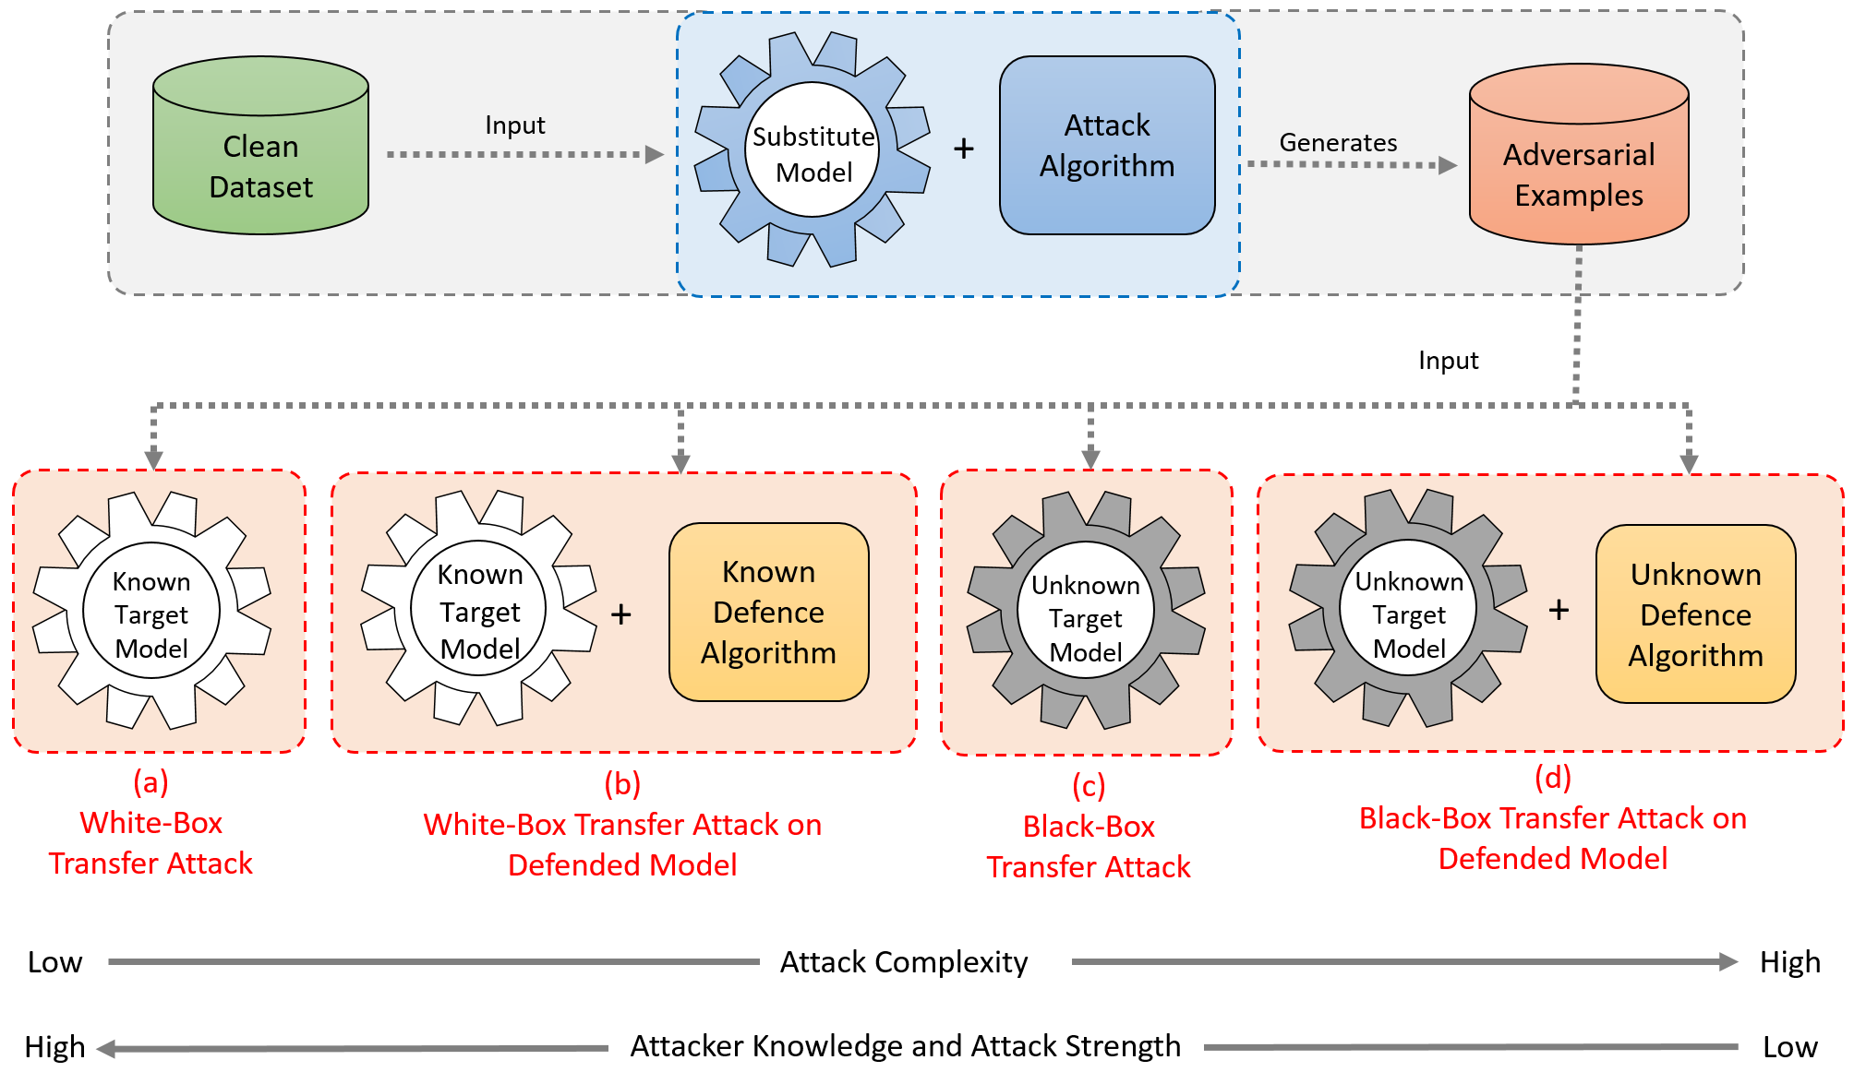
Four Scenarios
Notes:
We studded the transferable attacks and defences using the four scenarios.

Slide 16
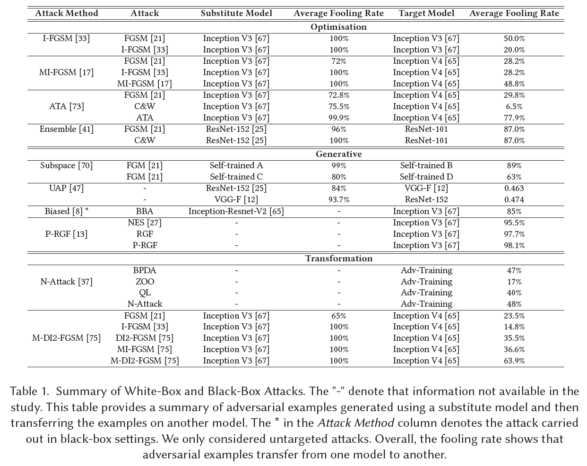
Notes:
• Optimisation: Uses optimisation algorithms.
• Generative: Probability distribution estimation.
• Transformation: Transformation techniques applied to input example before processing.

Slide 17
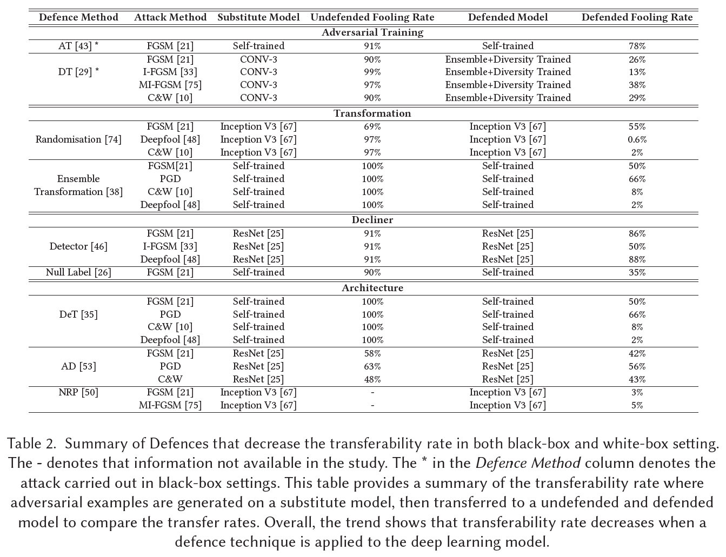
Notes:
• Adversarial Training: Use adversarial examples as part of training a model.
• Transformation: Pre-process the input example with various transformation techniques.
• Decliner: Does not process inputs with adversarial perturbation if detected.
• Architecture: Changes to the final layer or the architecture of a model.

Slide 18
Research Questions
Why do adversarial perturbations transfer from one model to another?
Transferability property is present due to a large amount of shared subspace between two models. [1]
High dimensionality indicates a high chance of shared subspace between two models.
Adversarial subspace generally occurs in clustered regions rather than random locations.
Can adversarial perturbations transfer from one architecture type to another?
Research shows that adversarial examples can transfer from one architecture to another.
[2] demonstrated this by using five architectures including Deep Neural Networks (DNNs), decision trees (DT), logistic regression (LR), support vector machines (SVM), ensembles (Ens), and nearest neighbors (kNN).
[1] Tramèr, F., Papernot, N., Goodfellow, I., Boneh, D. and McDaniel, P., 2017. The space of transferable adversarial examples. arXiv preprint arXiv:1704.03453.
[2] Papernot, N., McDaniel, P. and Goodfellow, I., 2016. Transferability in machine learning: from phenomena to black-box attacks using adversarial samples. arXiv preprint arXiv:1605.07277.

Slide 19
Research Questions
What is the best of type of defence will decrease transferability the most?
Challenging to compare all the defence methods and classify it as the "best“ defence method.
This is due to the fact that there are many different factors involved start from training the model initially to the end point of defending against a certain attack.
Factors include the dataset(s) the model was trained on, architecture type, type of white-box or black-box attacks.
[1] proposed that evaluating the robustness of defences can often be extremely difficult to evaluate and provides detailed recommendations on how to evaluate defence methods.
Does transferability differ between targeted attacks and non-targeted attacks? Why?
Non-targeted attacks are highly transferable from one model to another, whilst targeted are difficult to transfer.
[2] believed this is due to the gradient-based approach only searches in the 1-D subspace, which may only contain a small portion of all labels, resulting in not able to correctly classify the targeted label.
From a logical point of view, it is much easier to find a random incorrect output label than compared to a specific incorrect output label in the decision boundary subspace.
[1] Carlini, N., Athalye, A., Papernot, N., Brendel, W., Rauber, J., Tsipras, D., Goodfellow, I., Madry, A. and Kurakin, A., 2019. On evaluating adversarial robustness. arXiv preprint arXiv:1902.06705.
[2] Liu, Y., Chen, X., Liu, C. and Song, D., 2016. Delving into transferable adversarial examples and black-box attacks. arXiv preprint arXiv:1611.02770.

Slide 20
Future Research Opportunities

Slide 21
Future Research Opportunities
Evaluate adversarial transferability in Natural Language Processing domain.
Majority of the research conducted on adversarial transferability is in the Image Classification domain.
This leave opportunity to conduct experiments in NPL.
Applications include spam filtering, fake news detection and other text applications.
Evaluate the studied attack and defence methods under the same conditions.
Difficult to compare performance of methods if there is variation in training datasets, pre-trained model types, DNN architecture, training parameters, etc.
Some studies choose to self-train deep learning models, which makes it harder to compare performance for different attack and defence methods.
Studies use different perturbation strength
No distance metric is perfect and evaluating a good distance metric is a challenge that needs to be explored [1].
[1] Carlini, N. and Wagner, D., 2017, May. Towards evaluating the robustness of neural networks. In 2017 ieee symposium on security and privacy (sp) (pp. 39-57). IEEE.

Slide 23
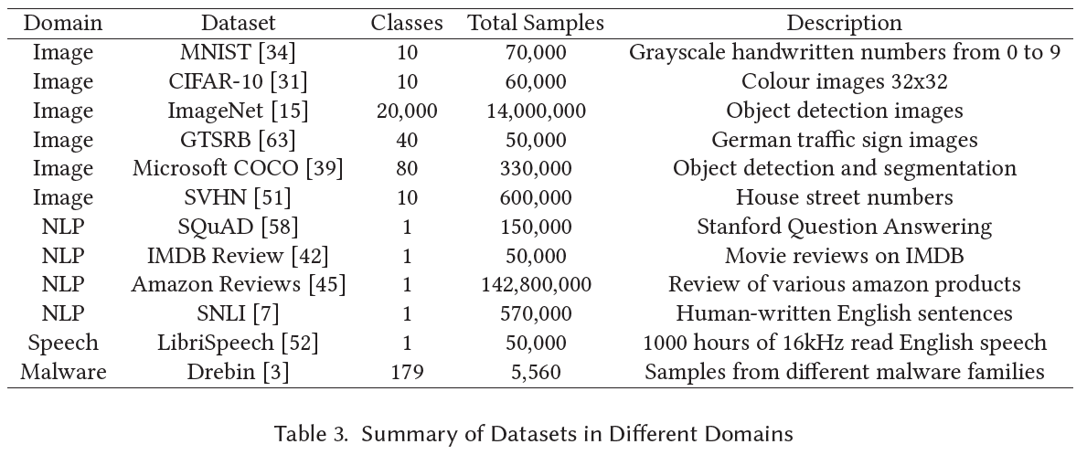
Datasets

Slide 24
Candidature Assessment 1 Progress

Slide 25
Progress
Submitted Paper
Gurparteek Singh, Yulei Sui, Ivor Tsang: Exploiting Transferability: A New Perspective of Studying the Adversarial Attacks and Defenses. (25 pages including references).
Submitted to: Association for Computing Machinery (ACM)
Requirements Completed
Technology Research Preparation (84/100)
Technology Research Methods (84/100)
Research Integrity Module
Research Data Management Plan
Research Safety Plan (Not required for this research project)

Slide 26
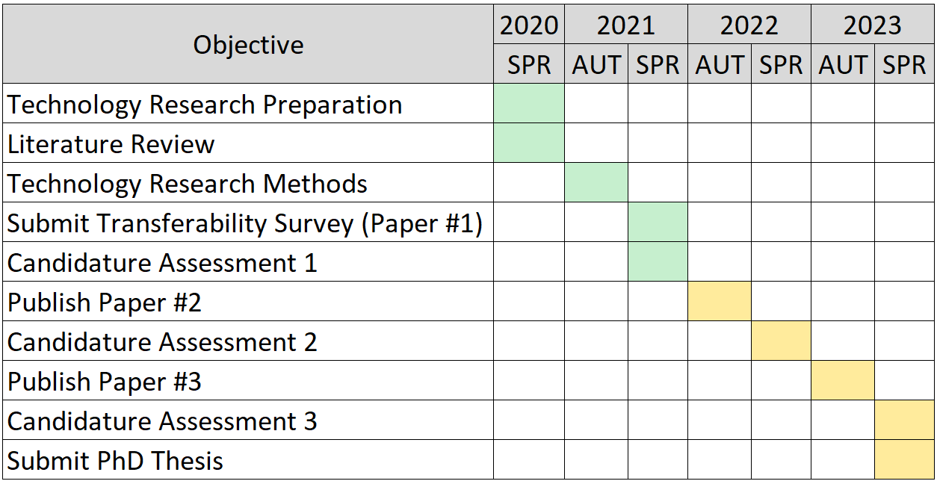
Timeline

Slide 27
Thank you for listening!
Q&A

